Slide 1
Online Container Scheduling for Data-intensive Applications in Serverless Edge Computing
Xiaojun Shang∗, Yingling Mao∗, Yu Liu∗, Yaodong Huang†, Zhenhua Liu‡, and Yuanyuan Yang∗,(INFOCOM 2023)

Slide 2
Background
Edge computing network:
For applications that require service with adequate reliability and low latency.
However, the computing and network resources are
more limited compared to cloud and core networks

Slide 3
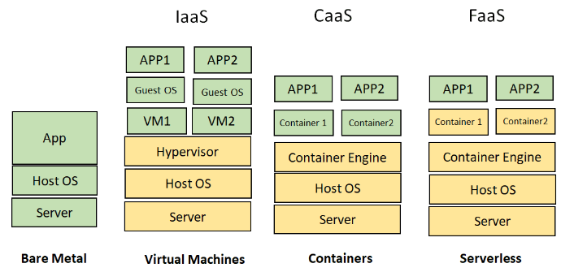
Background
Serverless Computing: Function as a Service (FaaS)

Slide 4
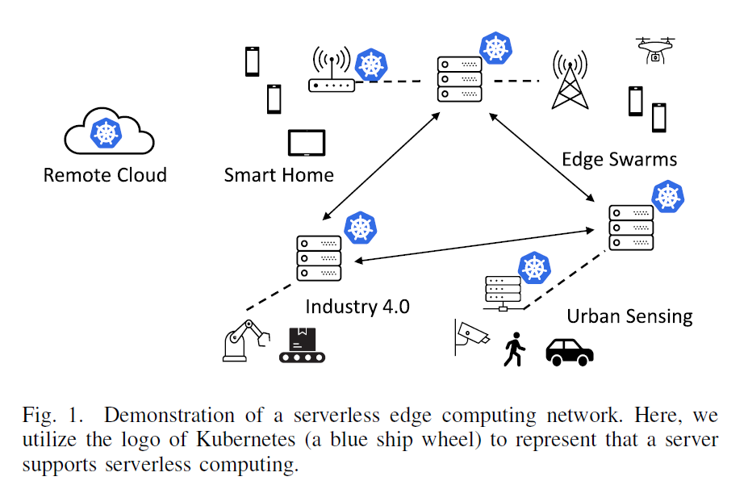
Background
Serverless Edge Computing:

Slide 5
Motivation: challenge of serverless edge computing
computation/data geo-dispersion and device/network heterogeneity of edge environments.
large transmission and execution delays that offset the benefits of the serverless paradigm.

Slide 6
Motivation:
existing work has not considered the heterogeneous network typologies at the network edge that may be much different from the cloud.
It is highly desirable to have a model that trades off delays and operating costs over the edge and the cloud

Slide 7
Objective
The authors aim to design an online container scheduling strategy for data-intensive applications to solve the problems in serverless edge computing mentioned above.

Slide 8
Contribution
the formulation of a joint container placement and flow routing problem.
2. The proposal of an Online Data-aware Container Scheduling (ODCS) algorithm.
3. The verification of the advantages of proposed algorithm through extensive simulations.

Slide 9
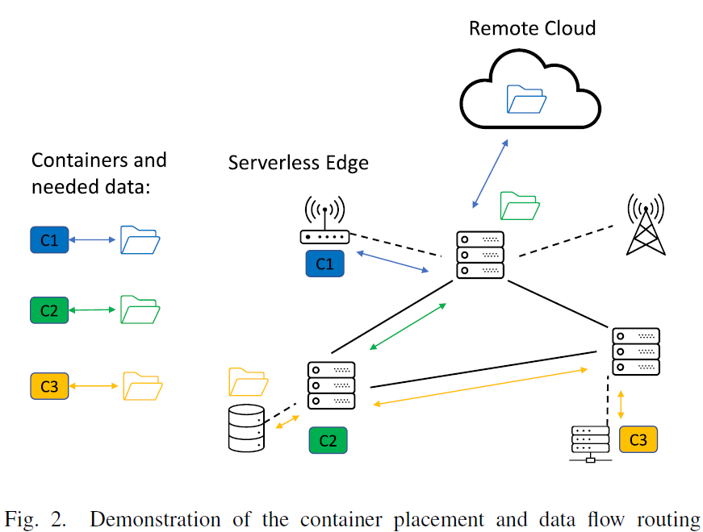
Model Formulation
Network environment:
Nodes
Containers
Links
Flows

Slide 10
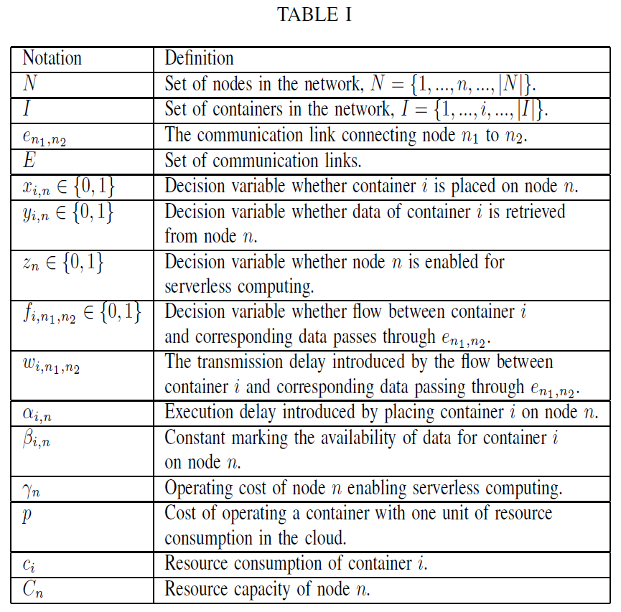

Slide 11


Model Formulation
Objective functions:
Transmission delay:
Execution delay:

Slide 12


Model Formulation
Objective functions:
Data availability:
Operating cost:

Slide 13



Model Formulation
Constraints:
Resource capacity:

Slide 14

Model Formulation
Constraints:
Flow conservations:
Binary variables:

Slide 15

Model Formulation
the data-aware container placement and flow
routing problem (P1 problem) :

Slide 16
Proposed Algorithm
A. The Hardness of P1:
P1 is at least strongly NP-complete even if container requests come in a batch and the problem could be solved in an offline manner
It is even harder to solve P1 with close performance to the optimal offline solution, which knows all future information in advance.

Slide 17
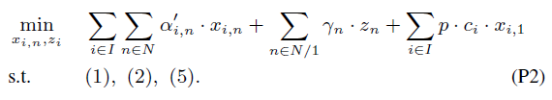
Proposed Algorithm
B. Online Algorithm Design:
Online Data-aware Container Scheduling (ODCS) algorithm is proposed to handle the placement and data flow routing of each arriving container request.
Updated Problem formulation (P2):

Slide 18
Proposed Algorithm
B. Online Algorithm Design:
Three choices of ODCS:
The first choice is to place the container on an edge node that has been initialized forserverless computing and has sufficient remaining resource capacity.
The second choice is to initialize a new edge node and deploy the container on it.
The third choice is to start the container in the remote cloud

Slide 19
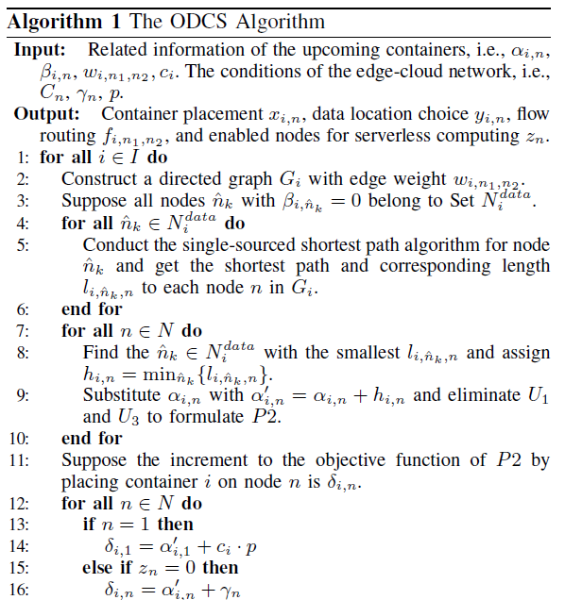

Slide 20
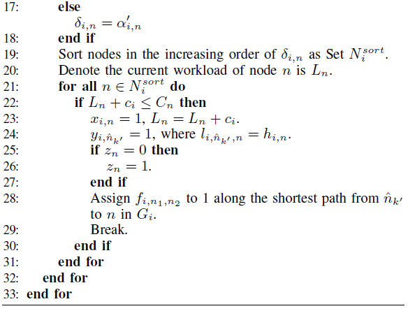

Slide 21
Proposed Algorithm
B. Online Algorithm Design:
Online Data-aware Container Scheduling (ODCS) algorithm is proposed to handle the placement and data flow routing of each arriving container request.
It is even harder to solve P1 with close performance to the optimal offline solution, which knows all future information in advance.

Slide 22
Proposed Algorithm
C. Theoretical analysis:
Theorem 1: For each request i, the container placement and routing decision of the ODCS algorithm is local optimum.

Slide 23
Proposed Algorithm
C. Theoretical analysis:
Theorem 2: Suppose the solution of the ODCS algorithm is S† and we have S∗ as the result of the optimal offline solution. Then, the competitive ratio between ODCS and the offline optimum is a constant, i.e., S† ≤ η ・ S∗. Here, the constant η will be defined in the following proof.

Slide 24
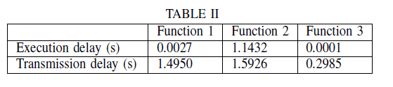
Simulation setup
Serverless Edge Computing Network:
two types of edge nodes, three types of functions

Slide 25
Simulation setup
Baseline Algorithms: ​
Data-aware placement algorithm (DAP):
Near-data placement algorithm (ND):
First placement then routing algorithm (FPTR):

Slide 26
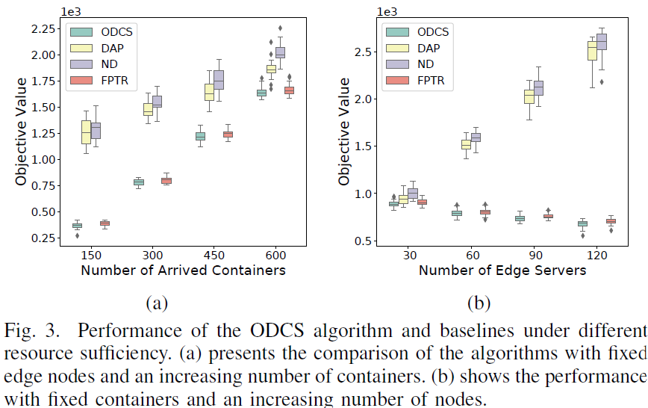
Evaluation result
The performance of ODCS with resource sufficiency variation.

Slide 27
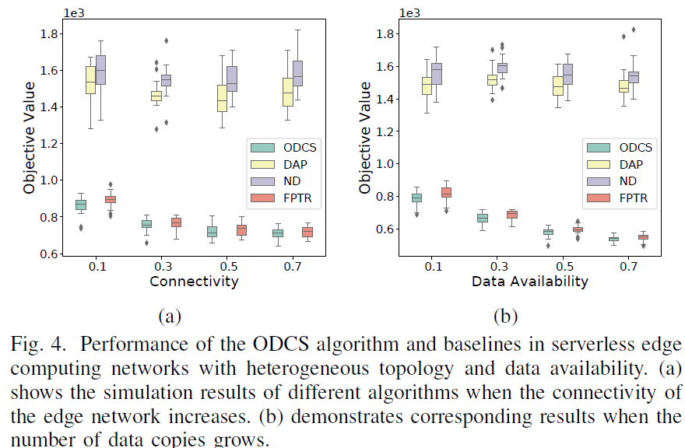
Evaluation result
The performance of ODCS with topology variation.

Slide 28
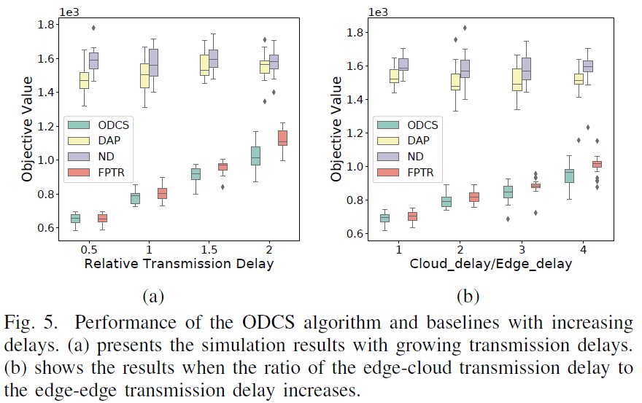
Evaluation result
The performance of ODCS with the influence of geo-distribution and heterogeneity of edge networks

Slide 29
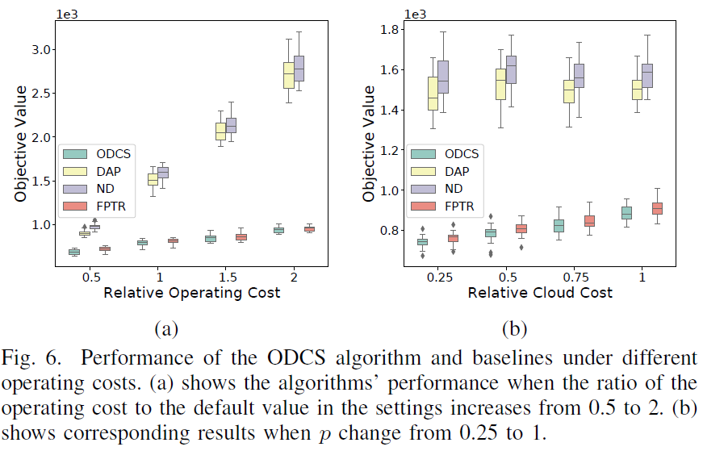
Evaluation result
The performance of ODCS with the effect of different operating costs

